Slide 1

INDUSTRIAL GROWTH IN TELANGANA BACKWARD DISTRICTS. BDM Capstone Project
23f3003307
Sri Kruthin P
BSMS2001

Slide 2


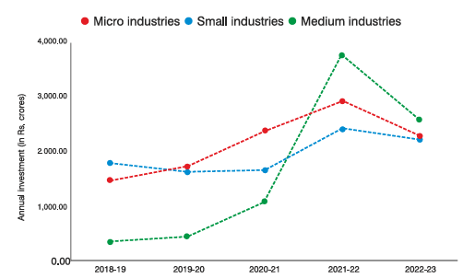
Organizational Background
Department
The Industries & Commerce Department, Telangana, looking after the Sections like Mines, Handlooms & Textiles, Industrial Establishment – Sugar Industries & Commerce, Export & Promotion, INF & IP (Infrastructure & Industrial Promotion), MSME-FP- Biotech.
TS-iPASS
The TS-iPASS is a single-window clearance system for investors in Telangana, simplifying business approvals and promoting ease of doing business.
Exports
The total export of 858,57,10,19,087 (INR) (i.e. 10,26,08,52,215 USD) between April -2024 To October -2024.
MSMEs in Telangana
Micro: 25,94,000
Small: 10,000
Medium: 1,000
Schemes
Composite Loan Scheme
Scheme for Acquisition of ISO series Certification by SSI Unit (RISO 9000)
National Equity Fund Scheme (NEF)
Scheme for Women Entrepreneurs (MUN)
Scheme for Technology Development and Modernization (RTDM)
Scheme for Textile Industry under Technology Upgradation Fund (RTUF)
Data Set
Data collected from the Telangana Government’s Open Data Portal.
https://data.telangana.gov.in/search/?page=2&theme=Industries

Slide 3
Project analysis slide 3
Defining Problem
Low exports despite high investments received in some areas.
Investment concentrated in only few districts. (3 of 31)
Lack of awareness of government incentives.
Certain districts like Jayshankar, Khammam have high investment, but exports are quite low.
Few districts getting huge amount for investment whereas remaining are getting less than 5% of investment.
Many local entrepreneurs don’t have proper awareness of govt incentives.

Slide 4
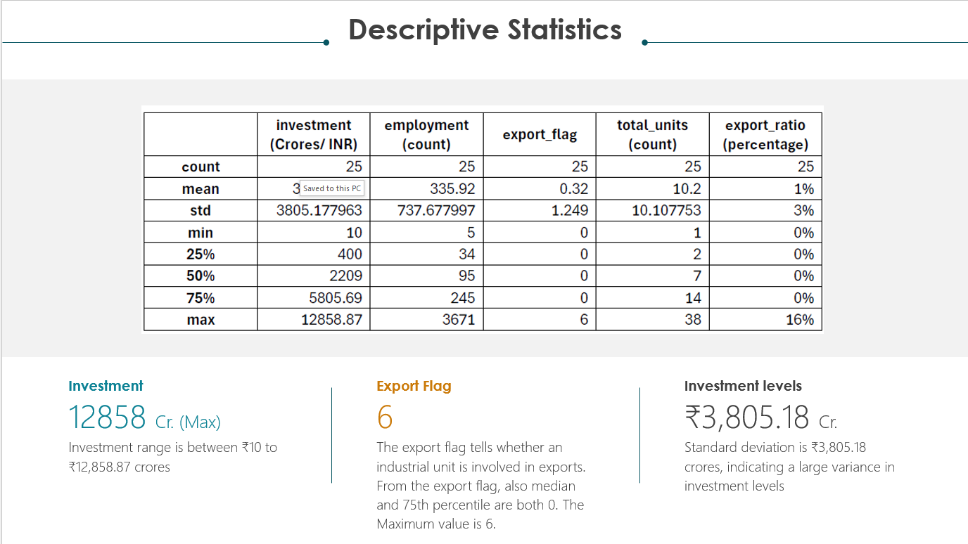
Project analysis slide 8
Data Overview Analysis Process
Industrial Incentives
This dataset provides information about the Industrial Incentives in Telangana for units set up in the state
The data set contains the below columns: | District | Mandal | Village | Unit_Name | Unit_Address | incentive_name |
Time Series Analysis
Data Processing
Regression Analysis
Identify the outliers using box plot method and removed them
Removing the missing values (& NaN).
Combined the data sets for 7 months of MSME datasets and incentives datasets.
Regression analysis is used to identify the relationships between dependent and independent variables “Investment” is an independent variable, and “Export Ratio” is a dependent variable.
Time series analysis is used to analyze the data collected over the period of 7 months to identify the monthly Investment in the top 3 districts of Telangana and awareness of incentives across districts.
Micro Small & Medium Enterprises (MSMEs)
This dataset provides information about the Micro Small & Medium Enterprises (MSMEs) in Telangana for units set up in the state.
Data contains the below columns: | district | mandal | indsutry_category | type_of_industry | unit_name | line_of_activity | investment | employment | present_status | export | type_of_connection |

Slide 5
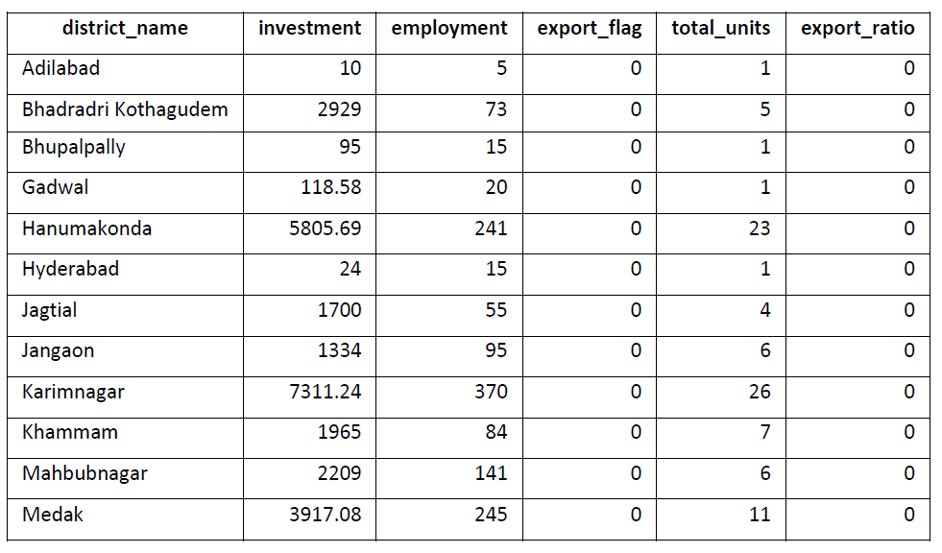
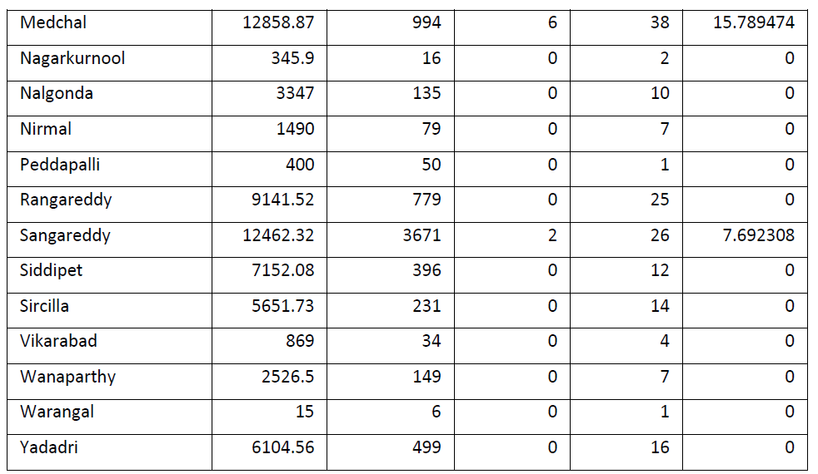
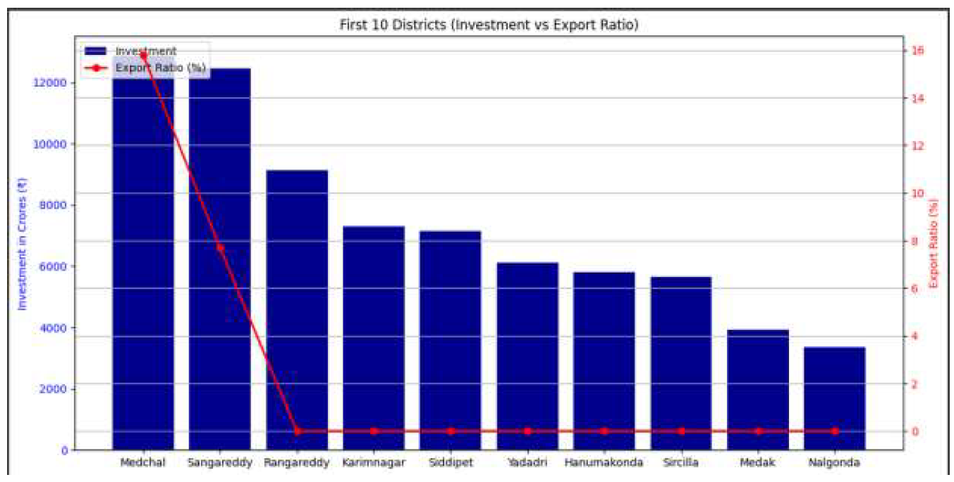
Project analysis slide 6
Low exports despite high investments received in some areas.
Medchal and Sanga Reddy are the only two districts that have exports. The remaining districts, despite having investments, do not have exports.
This table gives the descriptive statistics of investments along with the export ratio. (%).
The combination chart provides a single visualization that combines two or more different chart types.
The combination chart is plotted with investment and export ratio.

Slide 6
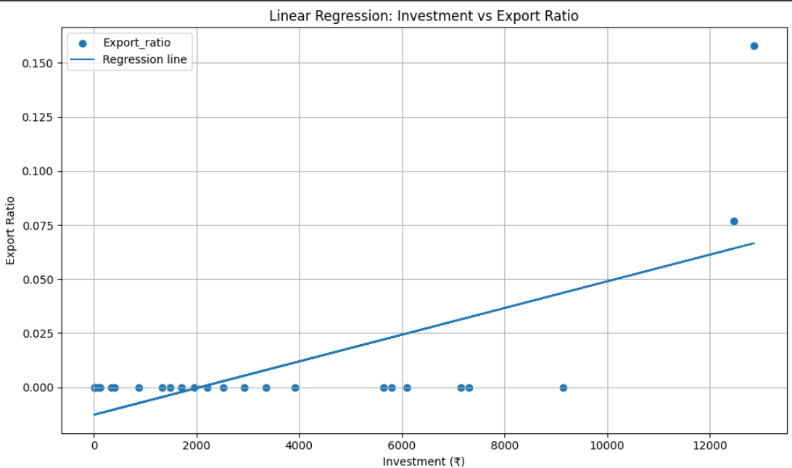
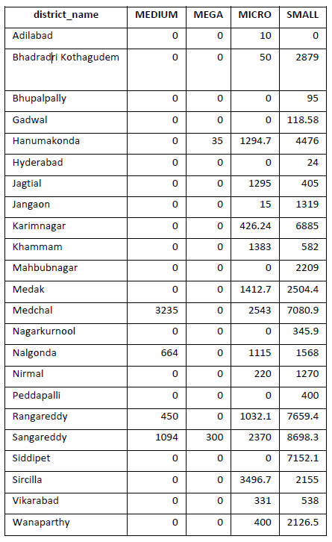
Project analysis slide 6
Low exports despite high investments received in some areas.
Further analysis has been done based on Industry Category.
In the Industry Category, there are four types.
Micro | Small | Medium | Mega
Based on this analysis, a decision has been made.
It is observed that most of the investments went to Small and Micro industries. Medium and Mega industries received a very small amount. Small and Micro focus on the domestic markets.
Due to very low investment in the Mega and Medium industries, the exports are marginal as the Mega and Medium industries focus on export markets.
Regression analysis was performed to plot the relationship between Investment and export ratio.
The blue line is the regression line is straight.
It indicates that with an increase in Investment, the export ratio also increases. The correlation (0.68) indicates a moderately strong positive correlation between Investment and the export ratio.
Regression Analysis showing that, with the increase in the investment, exports increase. It contradicts the statement.

Slide 7
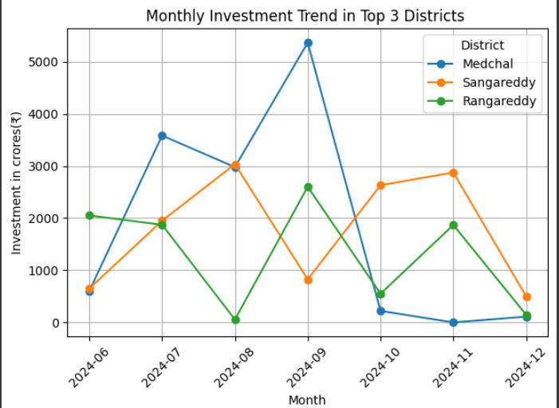
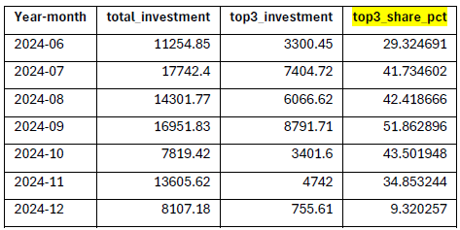
Project analysis slide 6
Investment concentrated in only few districts. (3 of 31)
The districts receiving the maximum amount of investment in the state are Medchal, Sangareddy, and Rangareddy..
From the analysis, most of the investments are given to these three districts. The Investments are not distributed evenly.
From the table. In September, the three districts account for more than 50 percent of the investment.
Investments are not evenly distributed among the districts. Unequal distributions lead to poor investment reception in a few districts, such as Adilabad, Warangal, Hyderabad, and Bhupalpally.
Unequal distribution dented the overall progress of the industries
Time series analysis is a way of analyzing a sequence of data points collected over an interval of time.
The above plotted chart is on multiple time series.
The time series analysis clearly shows the majority of the investment concentration for the top 3 districts.

Slide 8
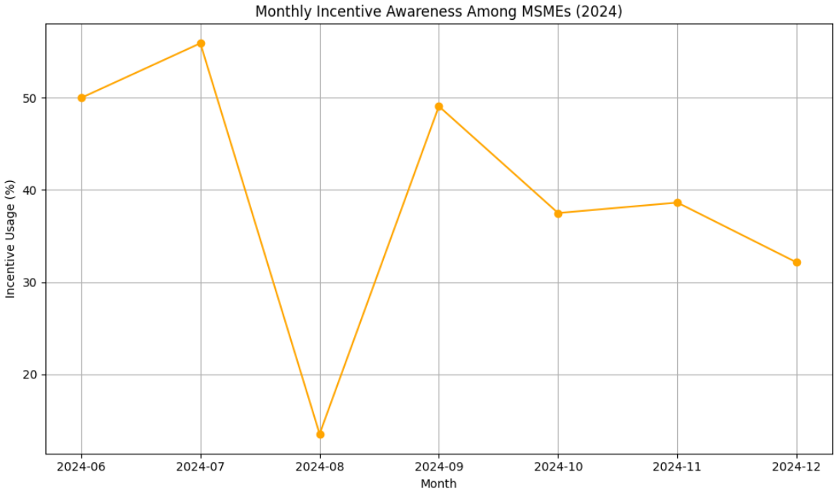
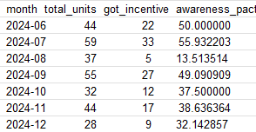
Project analysis slide 6
Lack of awareness of government incentives.
The time series analysis is performed on the incentives data for 6 months.
Comparing MSME and incentives data based on the unit name. created a column “Got incentive”. It takes the sum of the incentives received. Based on it, the awareness pact is calculated in terms of percentage. From the tables, awareness of the incentives is less than 60%.
The tables shows the monthly incentive awareness.
The Telangana Government provides incentives to industries.
Total MSMEs: 299 Units
Received incentives: 125
Incentive usage: 41.81%
Overall, only 125 units have received the benefits. The non-receiving units are unaware of the incentives.

Slide 9
Project analysis slide 6
Recommendations
Prescriptions to improve exports
Interpretations for unequal distribution
Suggestions for low awareness of incentives
Following the investment distributions as depicted below would be advantageous for export improvement.
Micro & Small Enterprises (MSEs): 45-50%
Medium Enterprises (MEs): 30-35%
Mega Industries: 25-30%
Investments should also be concentrated on mega and medium-sized industries. Since mega and medium enterprises focus on export markets.
Encourage medium and mega industry investments by offering additional export-linked subsidies.
Establish Export Facilitation Centers in backward districts.
Global Partnerships – Facilitate tie-ups between Telangana MSMEs and foreign buyers via trade expos and MoUs.
Unequal distribution of investments among the districts is also a reason for the poor export performance.
Introduce special investment packages for backward districts (tax rebates, faster clearances, land at concessional rates)..
Develop sector-specific industrial clusters in low-investment districts (example: food processing in Adilabad, textiles in Warangal).
The government should establish special export industrial zones to encourage industries in districts like Adilabad, Warangal, and Bhupalpally, among others.
If all districts receive an equal distribution of investments, employment will also be improved across the state.
The government should launch campaigns to promote industrial incentives across all districts and segments.
Focus on districts that do not have awareness of the incentive programs.
The government should provide more incentives and loans for mega industries to promote the export business.
Adilabad has low incentives as per the Analysis. More awareness programs are to be conducted in this District, along with encouraging investors to increase their Investment to enhance its export productivity.
Launch digital portals & mobile apps for easy access to scheme details, application tracking, and grievance redressal.

Slide 10
Project analysis slide 6
Conclusion
The analysis of industrial growth in Telangana’s backward districts highlights three significant challenges:
Low exports despite high investments, due to concentration in micro and small-scale industries.
Unequal investment distribution, with most funds flowing into only three districts.
Low awareness of government incentives, which prevents MSMEs in many districts from accessing available benefits.
Despite these issues, Telangana has immense potential for industrial diversification and export growth. By strategically shifting investments towards medium and large enterprises, ensuring equitable investment across all districts, and improving awareness of industrial incentives, the state can foster inclusive and sustainable industrial growth.
Next Steps
Policy – The Telangana government should adopt a “Balanced Industrial Development Policy” to reduce regional disparities and focus on export-oriented industries.
Monitoring – Develop a District Industrial Performance Dashboard to track investment, exports, and incentive utilization in real-time.
Public–Private Partnerships (PPP) – Encourage PPP models to build industrial parks in low-investment districts.
Thank you.

